Slide 1
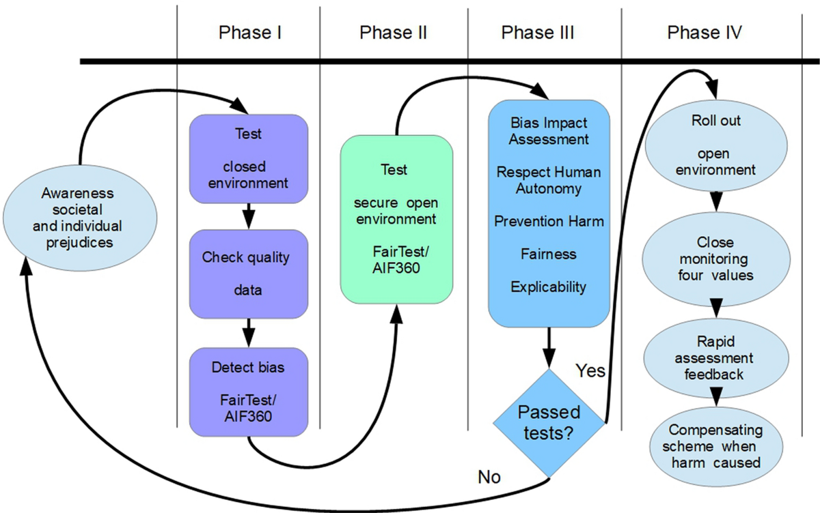
Bias Detection: Fighting Algorithmic Unfairness
Algorithmic Bias: Occurs when a model produces systematically prejudiced results (e.g., a medical AI that works better for one ethnic group than another).
Data Reflection: AI is a mirror; if the training data is biased, the model will be biased.
Audit Strategies: We must test models across different demographics (gender, age, location) to ensure "Equal Opportunity" and "Predictive Parity."

Slide 2
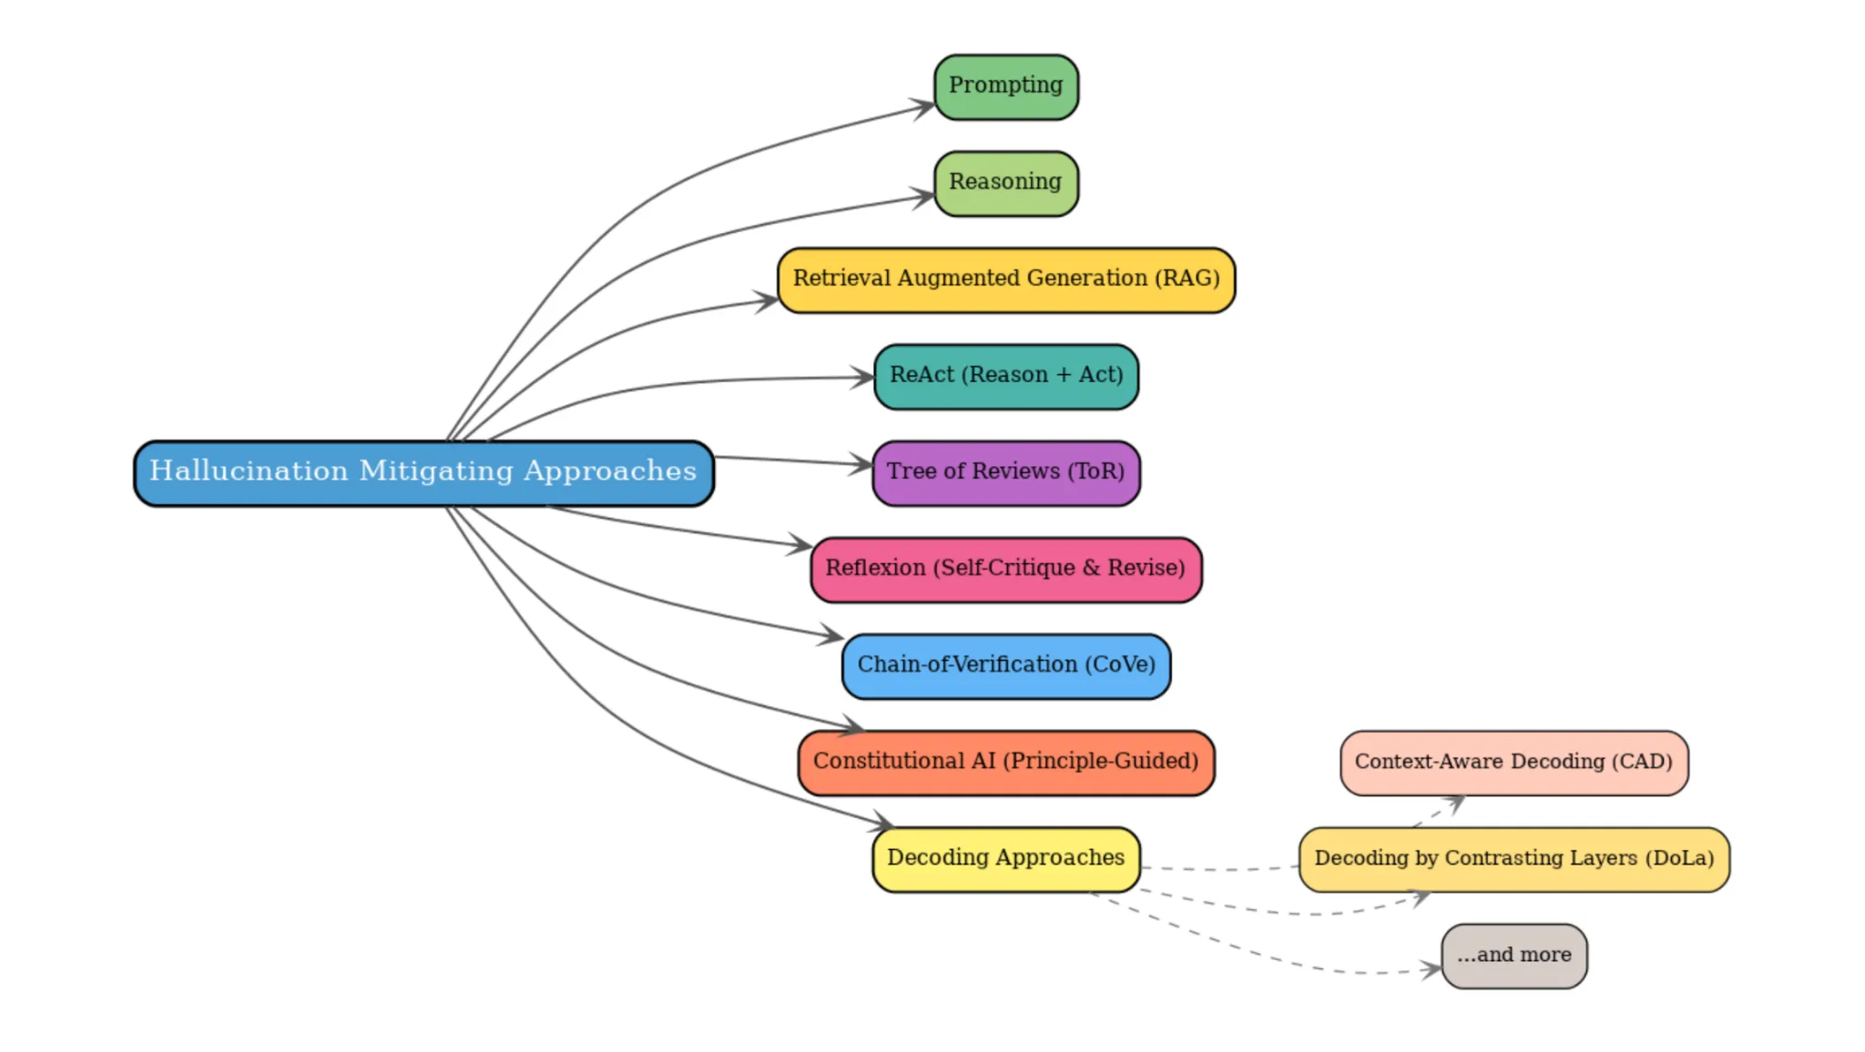
Hallucination Mitigation: The Quest for Truth
Hallucination: When an LLM confidently generates false information.
Root Cause: LLMs are "stochastic parrots"—they predict the most likely word, not necessarily the most truthful one.
Mitigation Strategies:
RAG: Grounding the model in external facts.
Self-Consistency: Asking the model to solve a problem multiple times and picking the consensus.
Verification Loops: Using a second "Judge" model to fact-check the first model's output.

Slide 3
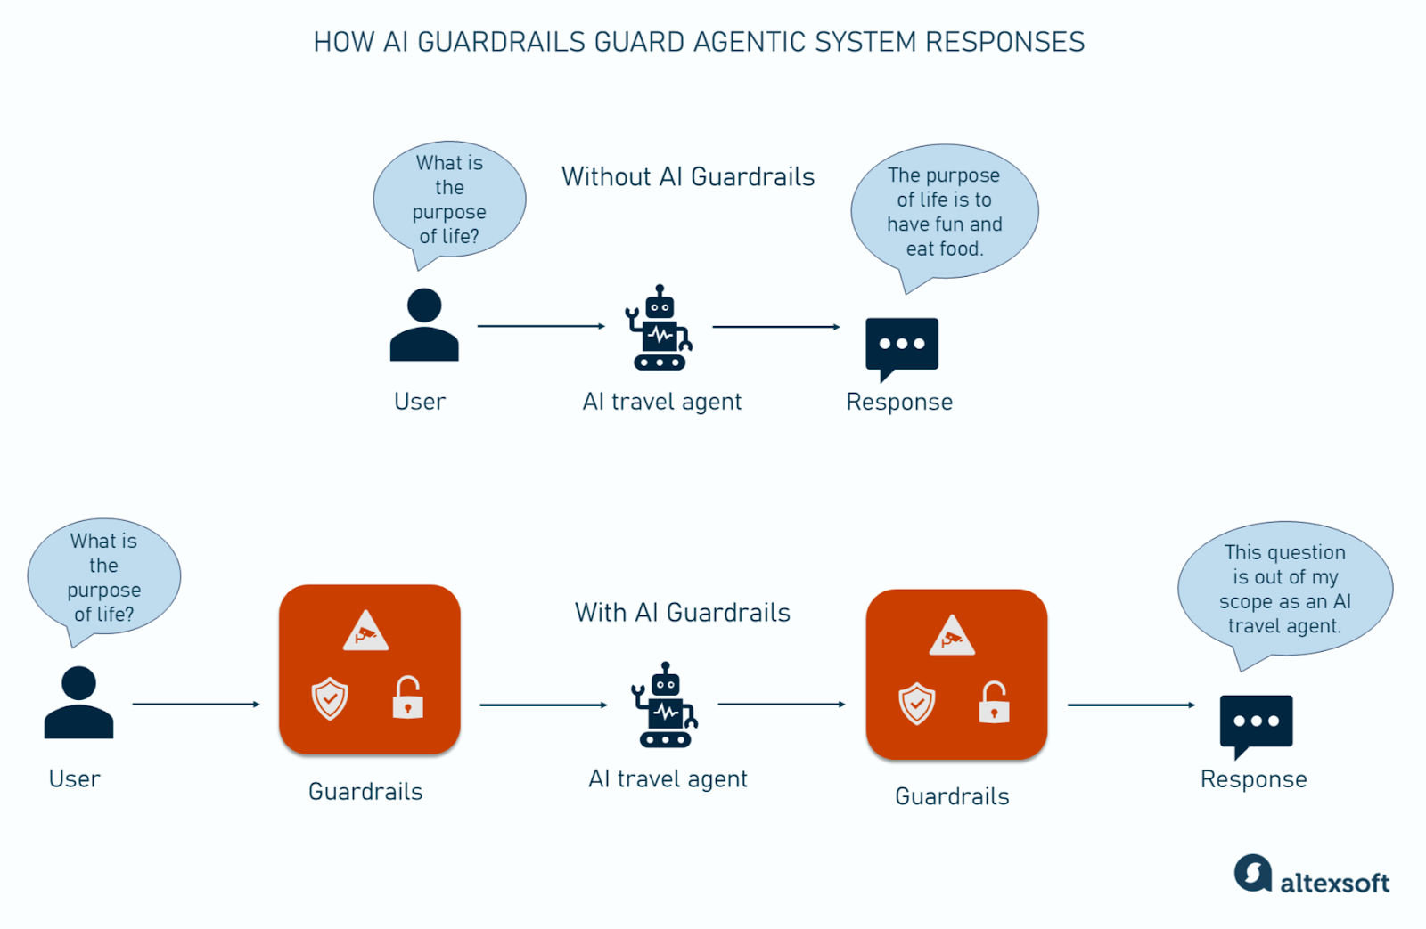
Deployment Safety: Building the Guardrails
Harmful Content: Preventing AI from generating instructions for illegal acts, hate speech, or self-harm.
Guardrails: Software layers that sit between the user and the AI (e.g., Llama Guard or NeMo Guardrails).
Red Teaming: The practice of intentionally trying to "break" the AI's safety rules to find vulnerabilities before the public does.

